Slide 1
Call Center Scheduling Problem
Sida Cai, Zhe Hu, Junqing Zhu

Slide 2
Executive Summary
An overview of the call center industry
Introduction to the call center scheduling problem
  Objectives
  Assumptions
Call Center Data
Erlang Model
  Assumptions
  Service time and impatience time
  Results
Monte Carlo Simulation
  Assumptions and methods
  Results

Slide 3
Call center and Customer Service
75% of customers believe it takes too long to reach a live agent
53% of customers are angry if they don’t speak to a real person right way
82% of customers have stopped doing business with company because of its bad customers service
95% of customers share their bad experiences with others
Call center:
  Inbound call center: customer service
  Outbound call center: telemarketing, market research and the seeking of charitable donations
In 2013, the revenue of telemarketing and call center services in the United Statistics reached approximately 18 billion U.S. dollars

Slide 4
Objectives and Assumptions
Objective:
  Minimize number of agents, given target acceptable waiting time and required service level
Assumptions:
  No precedence: Each call is not sequence dependent.
  Non preemptive: Calls are worked to completion once an agent picks up a call.
  Single queue
  FCFS: first come, first served

Slide 5
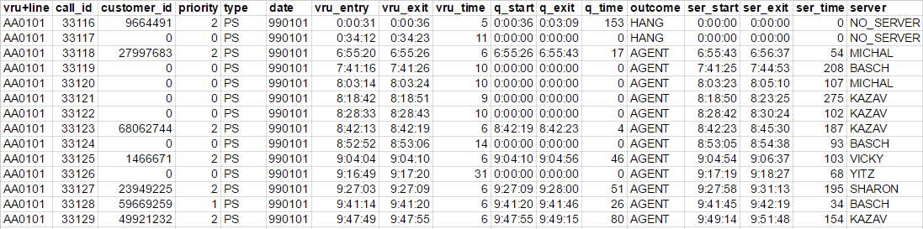
Call Center Data
Telephone data for a call center of an “anonymous bank” in Israel
12 months, 20,000 to 30,000 calls/month
Vru_entry: time of incoming calls
Vru_time: time spent in the Voice Response Unit
Q_start: time that customers enter queue
Q_time: time spent in the queue
Outcome: hang ups, services by an agent
Ser_time: time serviced by an agent

Slide 6
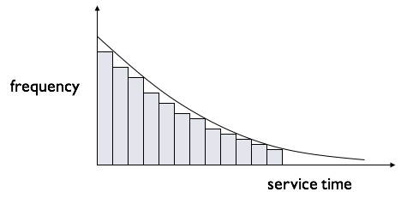

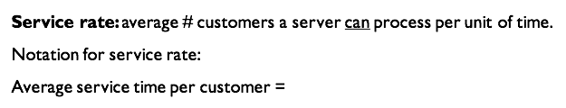
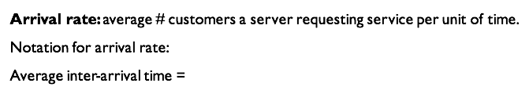


Two extra assumptions:
  Erlang model assumes that both service time and arrival time have a very specific, exponential distribution.
  Customers do NOT leave the system before being served; no abandonments
Erlang Model
Exponentially distributed service time
Exponentially distributed arrival time
Notes:
Waiting space is ample
A pool of service agents with identical skills and characteristics
Customers are serviced on a FIFO basis ; no priority classes

Slide 7
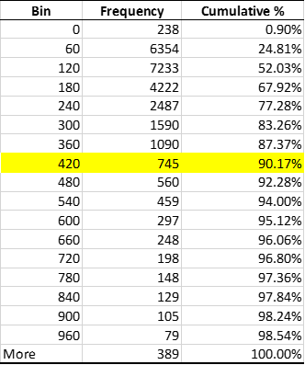
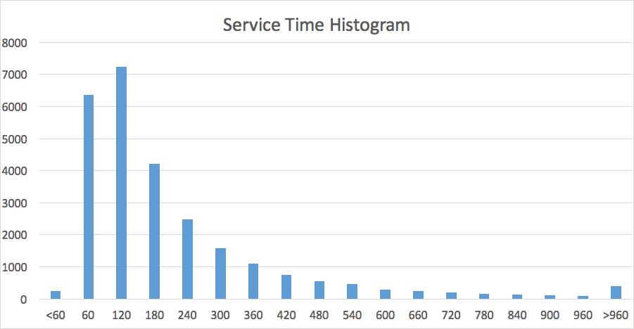
Service Time
90% service time is less than 420s

Slide 8
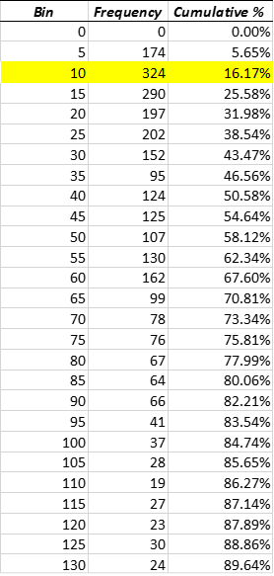
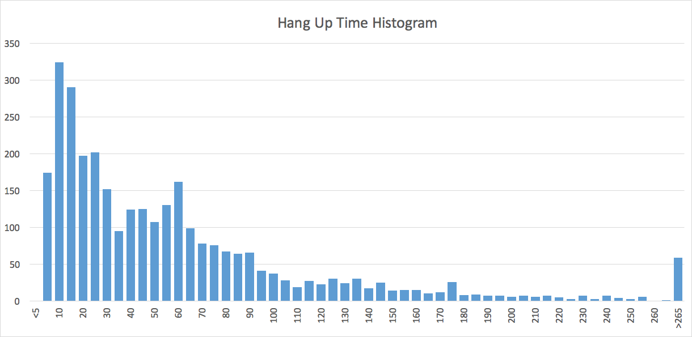
Impatience Time
Customers do NOT leave the system before being served; no abandonments
16% customers hang up within 10 seconds = 84% do NOT hang up within 10 seconds
Service Level:
percentage of customers whose waiting time is at or below the acceptable waiting time.
Target SL = 90% of all customers are served within 10 seconds

Slide 9

Formula
420s service time; 10s AWT; 90% service level; arrival rate
s= number of agents/servers
a= = offered load= minimum number of agents required
= a/s = utilization rate

Slide 10
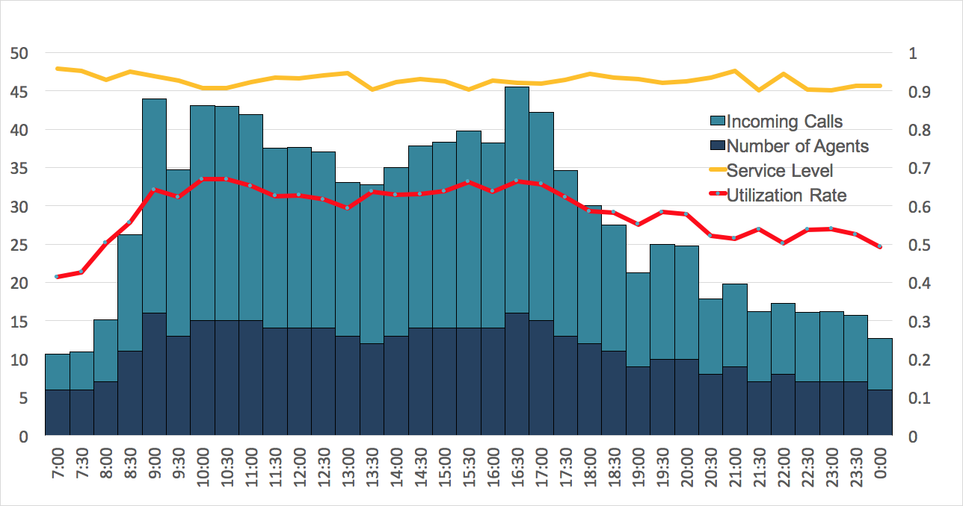
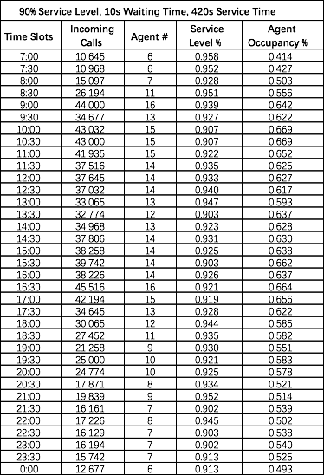
Erlang Model Results
Shift 3, 6 agents
Shift 1, 8 agents
Shift 2, 8 agents

Slide 11
Simulate Reality and Test Our Results
Assumptions:
  The arrivals are Poisson Process at different rates based on different time periods
  The service times are independent identical exponential distributed with a constant rate
  Customers independently get impatient with iid impatience times distributed as exponential at a constant rate
Methods:
  Simulating the time of incoming calls, service times and impatient times for different time period
  Using the Monte Carlo to estimate the number of incoming calls, number of impatient customers and service level
  Find the number of agents that achieves 90% service level on different time periods

Slide 12
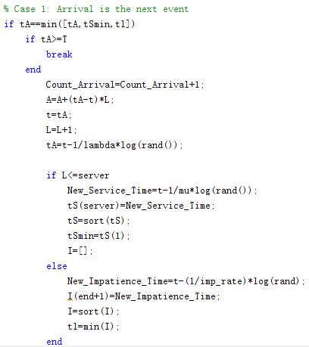
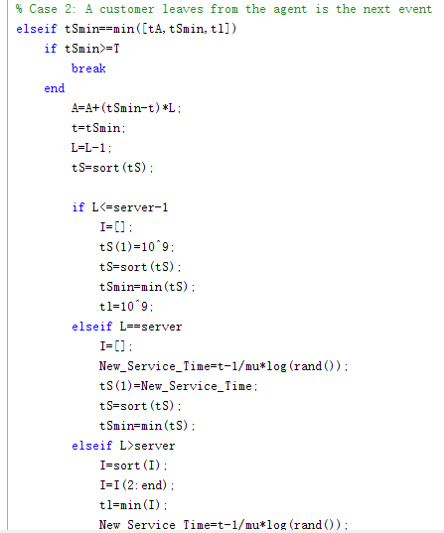
Example of Matlab Code

Slide 13
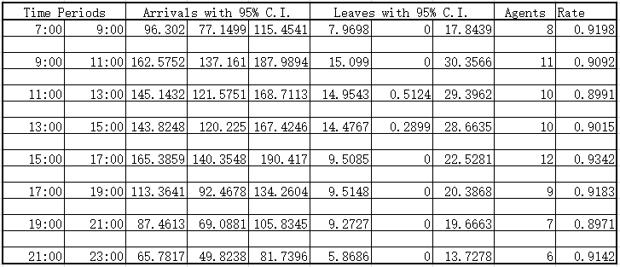
Simulation Result

Slide 14
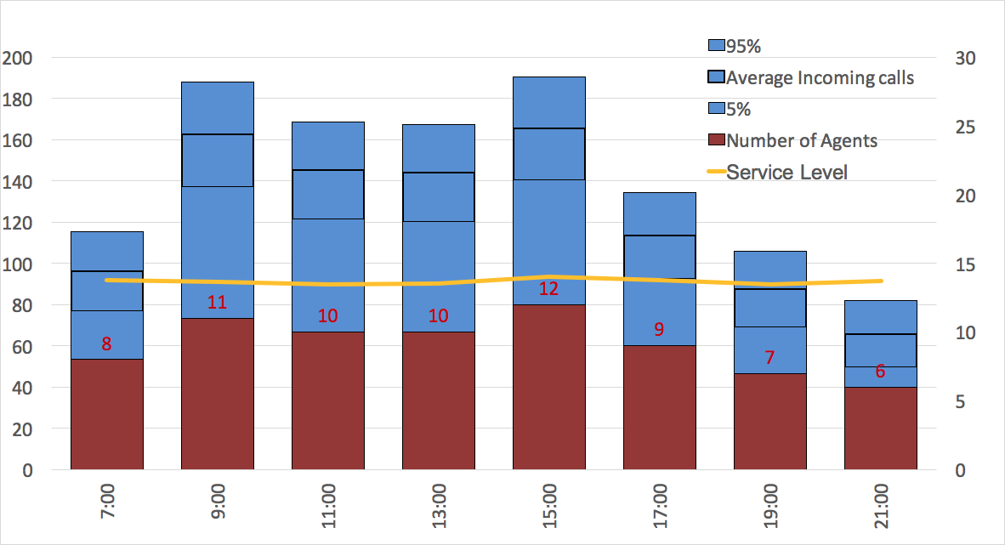
Simulation Result

Slide 15
Schedule Comparison
Current Schedule
Shift 1, 8 agents
Shift 2, 8 agents
Our Schedule
Shift 3, 5 agents
Shift 1, 8 agents
Shift 2, 8 agents
Notes:
The Service Level will increase significantly using our suggested schedule, which will increase approximately 20% in busy hours.

Slide 16
References
http://www.insightsquared.com/2015/04/100-customer-service-statistics-you-need-to-know/
http://www.newvoicemedia.com/blog/the-multibillion-dollar-cost-of-poor-customer-service-infographic/
https://www.zendesk.com/resources/the-impact-of-customer-service/
http://ie.technion.ac.il/serveng/callcenterdata/index.html
http://www.statista.com/topics/2169/call-center-services-industry-in-the-us/

